Slide 1
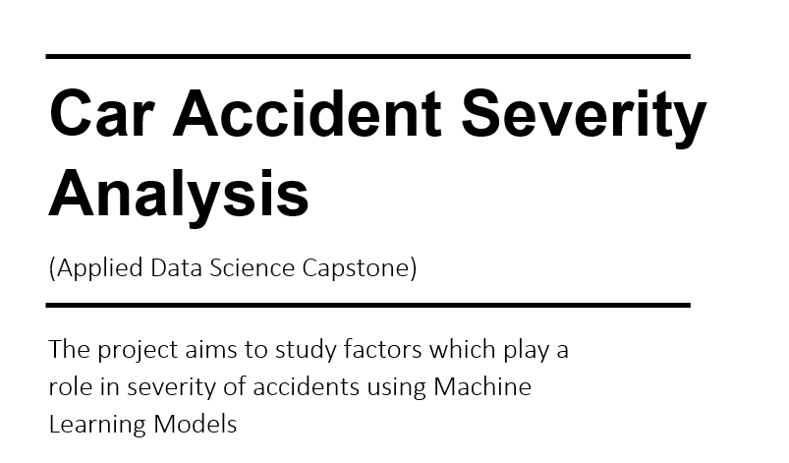
Presenter: RITESH CHAWLA

Slide 2
PROBLEM:
The increase in car ownership rates can lead to higher numbers of accidents on the road.
According to 2017 WSDOT data, a car accident occurs every 4 minutes and a person dies due to a car crash every 20 hours in the state of Washington while Fatal crashes went from 508 in 2016 to 525 in 2017, resulting in the death of 555 people.
STAKEHOLDERS:
Public Development Authority of Seattle
Road Designers
Vehicle Manufacturers

Slide 3
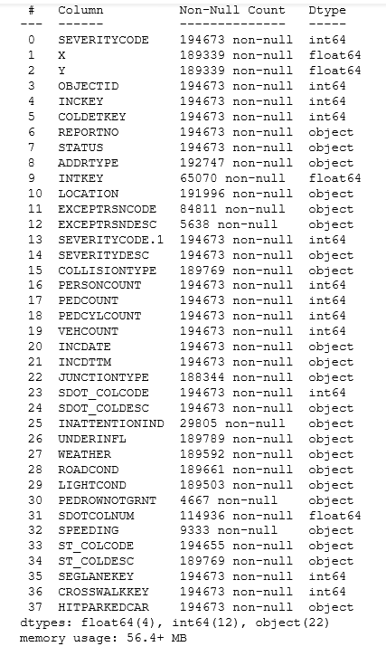
Data acquisition and cleaning:
This includes all types of collisions. Collisions will display at the intersection or mid-block of a segment. Timeframe: 2004 to Present
Dataset provided has 194,673 responses and 38 variables.
Data contains many null values/Blanks.
Finally selected 10 variables and target variable SEVERITYCODE.
Approximately 6% of data is lost in the process to remove blanks.
Feature Variables | Description
ADDRTYPE | Collision address type: • Alley • Block • Intersection
JUNCTIONTYPE | Category of junction at which collision took place
INATTENTIONIND | Whether or not collision was due to inattention. (Y/N
UNDERINFL | Whether or not a driver involved was under the influence of drugs or alcohol.
WEATHER | A description of the weather conditions duringthe time of the collision.
ROADCOND | The condition of the road during the collision.
LIGHTCOND | The light conditions during the collision.
PEDROWNOTGRNT | Whether or not the pedestrian right of way was not granted. (Y/N)
SDOT_COLCODE | A description of the collision corresponding tothe collision code.
SPEEDING | Whether or not speeding was a factor in the collision. (Y/N)

Slide 4
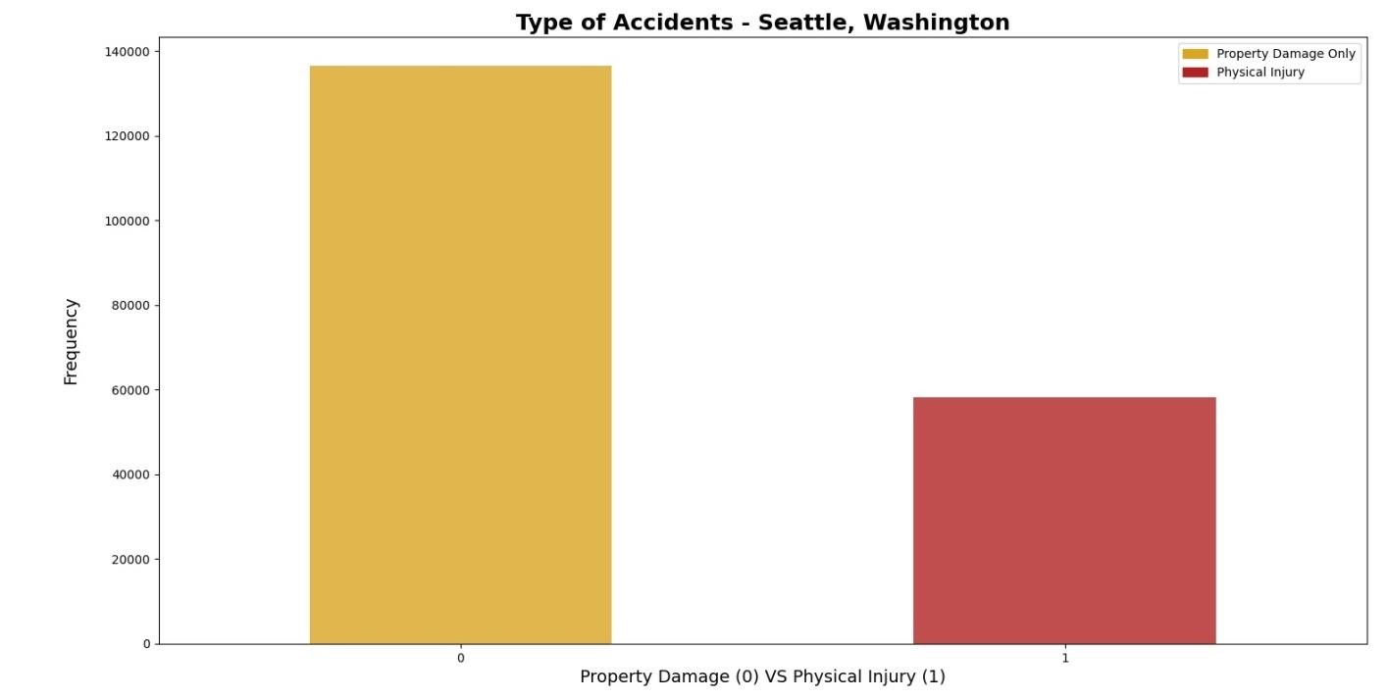
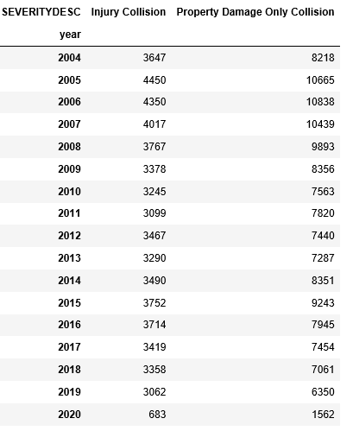
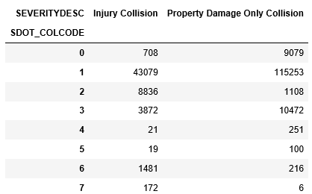
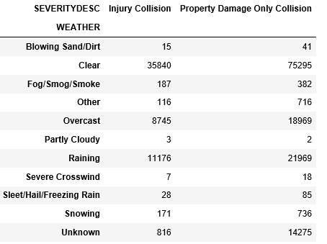
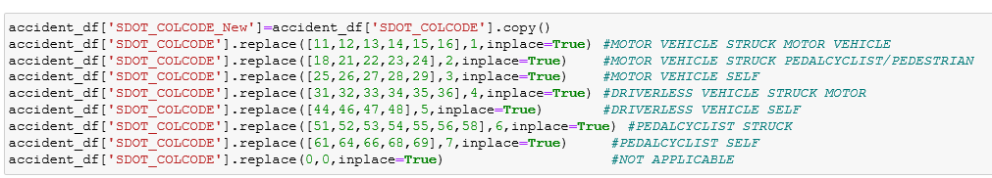
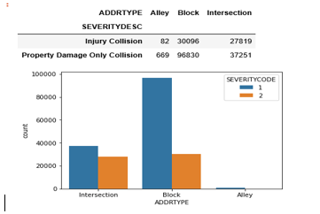
DATA INSIGHTS
The dataset has imbalance as clearly shown in figure. Physical Injury are less in number as per data.
Used SMOTE from imblearn to balance data.
Some more graphs and figures to show data.

Slide 5
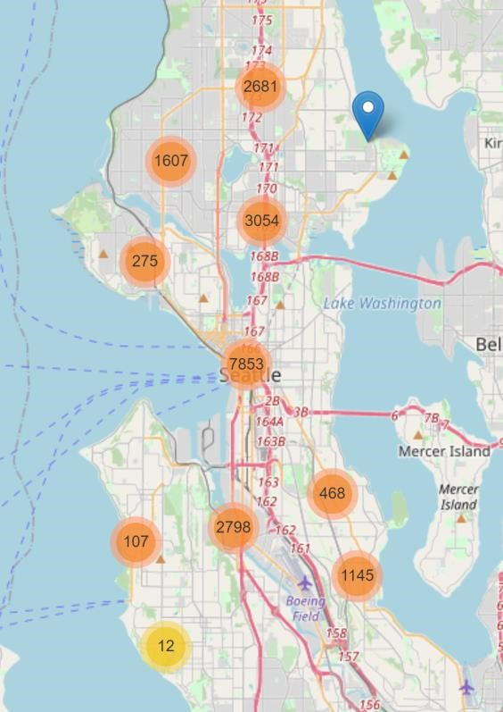
Be extra careful around the I-5 highway which goes through the city center since it has the highest proportion of accidents recorded of total seattle
Most incidents occur under adverse weather, road and light conditions. Precautions should be taken under such circumstances, for e.g. driving slow on a wet road which may lead to loss of control

Slide 6
Recommendations
After assessing the data and the output of the Machine Learning models, a few recommendations can be made for the stakeholders. The developmental body for Seattle city can assess how much of these accidents have occurred in a place where road or light conditions were not ideal for that specific area and could launch development projects for those areas where most severe accidents take place in order to minimize the effects of these two factors. Whereas, the car drivers could also use this data to assess when to take extra precautions on the road under the given circumstances of light condition, road condition and weather, in order to avoid a severe accident, if any.

